Slide 1

GitHub Copilot
Zhu Yang & Nick

Slide 2
Agenda
What is GitHub Copilot
What can we do with GitHub Copilot
How GitHub Copilot understand your code
How to write better prompts for GitHub Copilot
How to design your Copilot with LLM
How to quantify GitHub Copilot’s impact on developers
What is the next GitHub Copilot
Insights
References

Slide 3
What is GitHub Copilot
GitHub Copilot is an AI-powered pair programmer that assists developers by providing context-aware code suggestions and autocompletions. It leverages the power of GPT (Generative Pre-trained Transformer), including the Codex model, to understand code context and generate code snippets in real-time. It serves as a valuable coding companion, helping developers write code more efficiently, reducing errors, and accelerating the development process.

Slide 4
What is GitHub Copilot
GitHub Copilot is an AI-powered pair programmer that assists developers by providing context-aware code suggestions and autocompletions. It leverages the power of GPT (Generative Pre-trained Transformer), including the Codex model, to understand code context and generate code snippets in real-time. It serves as a valuable coding companion, helping developers write code more efficiently, reducing errors, and accelerating the development process.
Key words:
AI-powered pair programmer, context-aware code suggestions, autocompletions, GPT, Codex

Slide 5
What is GitHub Copilot
A brief history of Github Copilot
In June 2020, OpenAI released GPT-3, generating significant interest in developer communities, especially regarding code generation.
Prior to GPT-3, GitHub engineers had discussed the idea of code generation, but it was considered too challenging with existing models.
GPT-3 changed the landscape, demonstrating that the model was capable enough to explore code generation possibilities.
GitHub received access to OpenAI's API for experimenting with GPT-3 and assessing its abilities for coding tasks.
Initially, the GitHub Next team crowdsourced coding problems to evaluate the model's performance. However, they discontinued this method because the model became exceptionally proficient.
The model's success in solving coding problems inspired the team to consider building an AI-powered chatbot for developers.
They created a prototype chatbot, but they eventually realized that integrating it into the Integrated Development Environment (IDE) was a more effective approach.
Moving to the IDE, they developed GitHub Copilot, an interactive tool that provides real-time code assistance, surpassing the static question-and-answer format.
Notes:
GitHub工程师第一次与OpenAI的LLMs合作的经历，以及他们对LLMs能力的惊叹和兴奋。这次合作最终导致了GitHub Copilot的诞生。

Slide 6

What can we do with GitHub Copilot
Code Generation
Documentation Assistance
Code Autocompletion
Code Formatting
Error Handling
More…
Muli-Language Support
Unit Testing
Notes:
Code Autocompletion: Copilot provides context-aware code autocompletion suggestions as you type, helping you write code faster and with fewer errors.
Code Generation: It can generate entire code blocks, functions, classes, and more based on your context and requirements.
Documentation Assistance: Copilot can generate code comments and documentation for your code, making it easier for you and your team to understand and maintain the codebase.
Code Formatting: It can help with code formatting, adhering to best practices and coding standards.
Error Handling: Copilot can suggest error-handling code and provide solutions to common coding mistakes.
Multi-Language Support: It supports multiple programming languages and can assist in various development tasks, regardless of the language used.
Machine Learning Integration: GitHub Copilot can be particularly helpful for machine learning and data science tasks, as it can generate code for data preprocessing, model building, and more.
Version Control Integration: It integrates seamlessly with Git and GitHub, helping you manage version control and collaborate with others efficiently.
Unit Testing: Copilot can assist in generating unit tests for your code, ensuring better code quality and reliability.
IDE Integration: It's integrated with popular Integrated Development Environments (IDEs) like Visual Studio Code, making it accessible to a wide range of developers.
Customization: You can customize Copilot's behavior and preferences according to your coding style and project requirements.
Code Review: It can help in generating code for code reviews, ensuring that your code adheres to best practices and guidelines.
Learning and Improvement: GitHub Copilot continuously learns from the code you write, adapting to your coding style and becoming more effective over time.
Enhanced Productivity: By providing real-time code suggestions and reducing the need for manual coding, Copilot significantly enhances developer productivity.

Slide 7
How GitHub Copilot understand your code
Prompt Creation
GitHub Copilot uses a technique called "prompt engineering" to create prompts. Prompts are compilations of Integrated Development Environment (IDE) code and relevant context that are fed to the Codex model. These prompts are generated by algorithms in the background, and they can be created at any point while you're coding.
Notes:
Prompt Creation: GitHub Copilot uses a technique called "prompt engineering" to create prompts. Prompts are compilations of Integrated Development Environment (IDE) code and relevant context that are fed to the Codex model. These prompts are generated by algorithms in the background, and they can be created at any point while you're coding.
Contextual Understanding: GitHub Copilot's effectiveness relies on its contextual understanding. The model initially considered only the file you were working on in your IDE to be contextually relevant. However, it has evolved to consider your entire codebase to generate customized suggestions.
Neighboring Tabs: GitHub Copilot employs a technique known as "neighboring tabs." This feature allows the tool to process all of the files open in a developer's IDE, not just the one they are actively working on. It combs through all the data in these open files and finds matching pieces of code between them and the code around the developer's cursor.
Fill-In-the-Middle (FIM) Paradigm: FIM widens the context aperture even further. It allows GitHub Copilot to offer better coding suggestions based on the code that should come between the prefix (code before the cursor) and the suffix (code after the cursor).
Vector Databases: GitHub is experimenting with vector databases to provide a customized coding experience, especially for private repositories and proprietary code. These databases use embeddings to capture semantic information about code snippets. Algorithms create embeddings for all code snippets in the repository and store them in the vector database. As you code, the tool embeds the snippets in your IDE and searches for approximate matches between your code and the snippets in the database.
Semantic Understanding: The embeddings created by LLMs capture not only the syntax but also the semantics of code. This allows GitHub Copilot to understand the meaning and intention behind the code, not just the structure.

Slide 8
How GitHub Copilot understand your code
Contextual Understanding
GitHub Copilot's effectiveness relies on its contextual understanding. The model initially considered only the file you were working on in your IDE to be contextually relevant. However, it has evolved to consider your entire codebase to generate customized suggestions.
Notes:
Prompt Creation: GitHub Copilot uses a technique called "prompt engineering" to create prompts. Prompts are compilations of Integrated Development Environment (IDE) code and relevant context that are fed to the Codex model. These prompts are generated by algorithms in the background, and they can be created at any point while you're coding.
Contextual Understanding: GitHub Copilot's effectiveness relies on its contextual understanding. The model initially considered only the file you were working on in your IDE to be contextually relevant. However, it has evolved to consider your entire codebase to generate customized suggestions.
Neighboring Tabs: GitHub Copilot employs a technique known as "neighboring tabs." This feature allows the tool to process all of the files open in a developer's IDE, not just the one they are actively working on. It combs through all the data in these open files and finds matching pieces of code between them and the code around the developer's cursor.
Fill-In-the-Middle (FIM) Paradigm: FIM widens the context aperture even further. It allows GitHub Copilot to offer better coding suggestions based on the code that should come between the prefix (code before the cursor) and the suffix (code after the cursor).
Vector Databases: GitHub is experimenting with vector databases to provide a customized coding experience, especially for private repositories and proprietary code. These databases use embeddings to capture semantic information about code snippets. Algorithms create embeddings for all code snippets in the repository and store them in the vector database. As you code, the tool embeds the snippets in your IDE and searches for approximate matches between your code and the snippets in the database.
Semantic Understanding: The embeddings created by LLMs capture not only the syntax but also the semantics of code. This allows GitHub Copilot to understand the meaning and intention behind the code, not just the structure.

Slide 9
How GitHub Copilot understand your code
Neighboring Tabs
GitHub Copilot employs a technique known as "neighboring tabs." This feature allows the tool to process all of the files open in a developer's IDE, not just the one they are actively working on. It combs through all the data in these open files and finds matching pieces of code between them and the code around the developer's cursor.
Notes:
GitHub Copilot的“邻近标签”是一项功能，允许GitHub Copilot处理您的集成开发环境（IDE）中当前打开的所有文件，而不仅仅是您正在积极工作的单个文件。这个功能帮助GitHub Copilot从项目中打开的文件中收集额外的上下文，使其提供的代码建议更相关和准确。
当您在IDE中打开多个文件时，GitHub Copilot可以分析并考虑这些文件中的代码和上下文，以提供编码建议。这种增强的上下文理解可以导致更有帮助和与上下文相关的代码建议，最终提高您的编码体验和生产力。
实际上，邻近标签扩大了GitHub Copilot可以使用的信息范围，以帮助您完成编码任务，确保它考虑整个项目的上下文，而不仅仅是当前活动的文件。这个功能旨在使GitHub Copilot在理解和生成整个代码库上下文的情况下更加有效。

Slide 10
How GitHub Copilot understand your code
Fill-In-the-Middle (FIM) Paradigm
FIM widens the context aperture even further. It allows GitHub Copilot to offer better coding suggestions based on the code that should come between the prefix (code before the cursor) and the suffix (code after the cursor).
Notes:
"Fill-In-the-Middle"（FIM）是GitHub Copilot使用的一种技术，用于提高其上下文理解能力并提供更好的代码建议。在使用FIM之前，该模型仅将开发人员光标之前的代码（称为“前缀”）视为生成代码建议的上下文，并忽略光标之后的代码（称为“后缀”）。
有了FIM，GitHub Copilot现在可以理解和利用代码的前缀和后缀部分作为上下文。这意味着即使您正在文件中间的代码段上工作，您的光标位于那里，Copilot也可以通过考虑当前光标位置之前和之后应该出现的代码来提供更好的编码建议。
FIM增强了该模型生成上下文相关代码建议的能力，使其在各种编码任务中更有效地帮助开发人员。这项技术显着提高了AI合作编程工具理解和响应开发人员编码上下文的能力，最终提升了编码体验。

Slide 11
How GitHub Copilot understand your code
Vector Databases
GitHub is experimenting with vector databases to provide a customized coding experience, especially for private repositories and proprietary code. These databases use embeddings to capture semantic information about code snippets. Algorithms create embeddings for all code snippets in the repository and store them in the vector database. As you code, the tool embeds the snippets in your IDE and searches for approximate matches between your code and the snippets in the database.
Notes:
GitHub Copilot的向量数据库是GitHub Copilot架构的一部分，用于提高语义理解并为开发人员提供定制的编码体验。它在帮助Copilot理解您的代码上起着至关重要的作用，并生成相关的代码建议。
以下是GitHub Copilot向量数据库的工作原理：
什么是向量数据库：向量数据库是一种索引高维向量的数据库。这些向量是对象的数学表示，可以捕捉对象的各种复杂性。
高维向量：高维向量用作代码片段的表示。这些向量捕捉了代码的语法和语义，使它们能够传达代码的含义，而不仅仅是其结构。
工作原理：GitHub Copilot的算法为存储库中的所有代码片段创建嵌入（高维向量）。这些嵌入代表了代码的语法和语义。
实时匹配：在您编写代码时，GitHub Copilot的算法会将代码片段嵌入到您的集成开发环境（IDE）中。然后，在实时模式下，算法会在您的IDE代码片段的嵌入和已经存储在向量数据库中的嵌入之间进行近似匹配。
检索相关信息：向量数据库允许算法快速搜索近似匹配，即使它存储了大量的嵌入式代码片段。它有助于Copilot从您的代码库中检索相关信息。
语义理解：通过使用嵌入和向量数据库，Copilot不仅可以考虑语法，还可以考虑代码背后的语义和意图。它有助于Copilot生成更具上下文相关性和有意义的代码建议。
向量数据库特别适用于在私有存储库或专有代码上工作的开发人员。它增强了Copilot提供定制代码建议和更有效地理解开发人员编码上下文的能力。
请注意，向量数据库是正在进行的研究和实验的一部分，其开发旨在进一步提高GitHub Copilot在协助开发人员方面的功能。

Slide 12
How GitHub Copilot understand your code
Semantic Understanding
The embeddings created by LLMs capture not only the syntax but also the semantics of code. This allows GitHub Copilot to understand the meaning and intention behind the code, not just the structure.
Notes:
总体而言，GitHub Copilot 会根据您的编码活动不断生成提示，并且这些提示经过精心设计，可提供最有用的预测来帮助您完成编码任务。该工具的上下文理解随着时间的推移而不断发展，通过提供上下文相关且有用的代码建议，使其成为开发人员的宝贵助手。

Slide 13
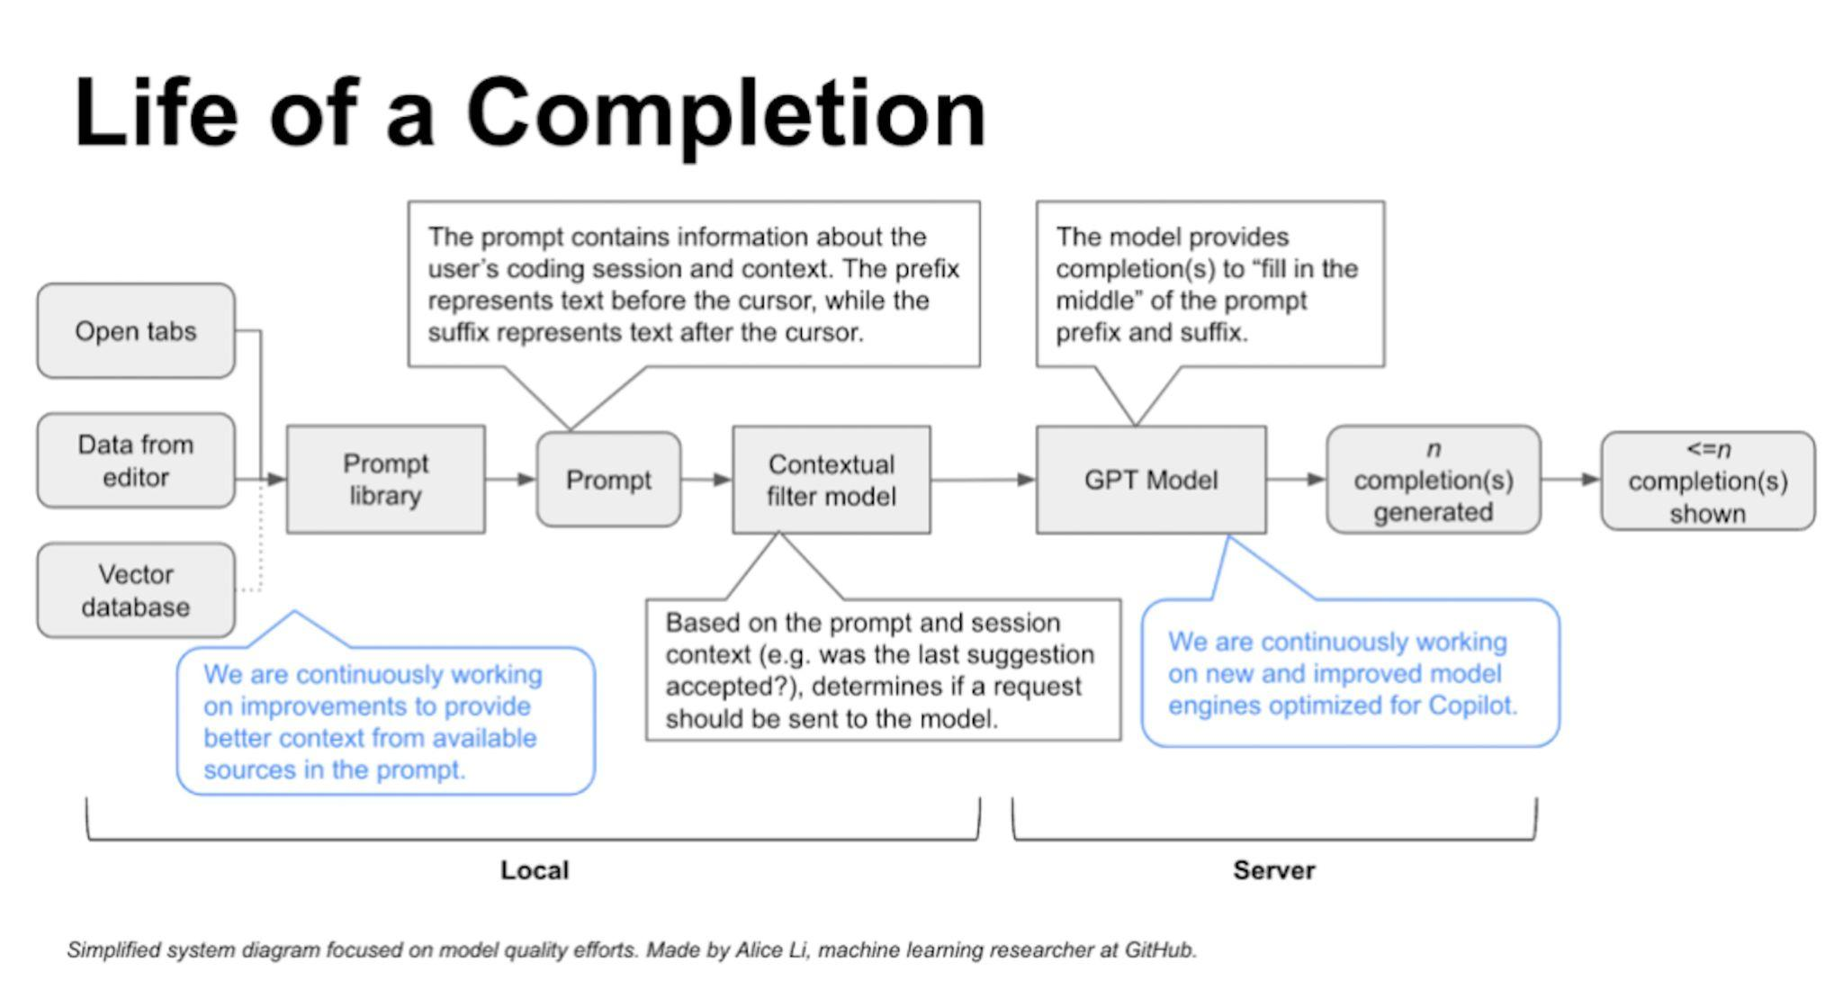
How GitHub Copilot understand your code

Slide 14
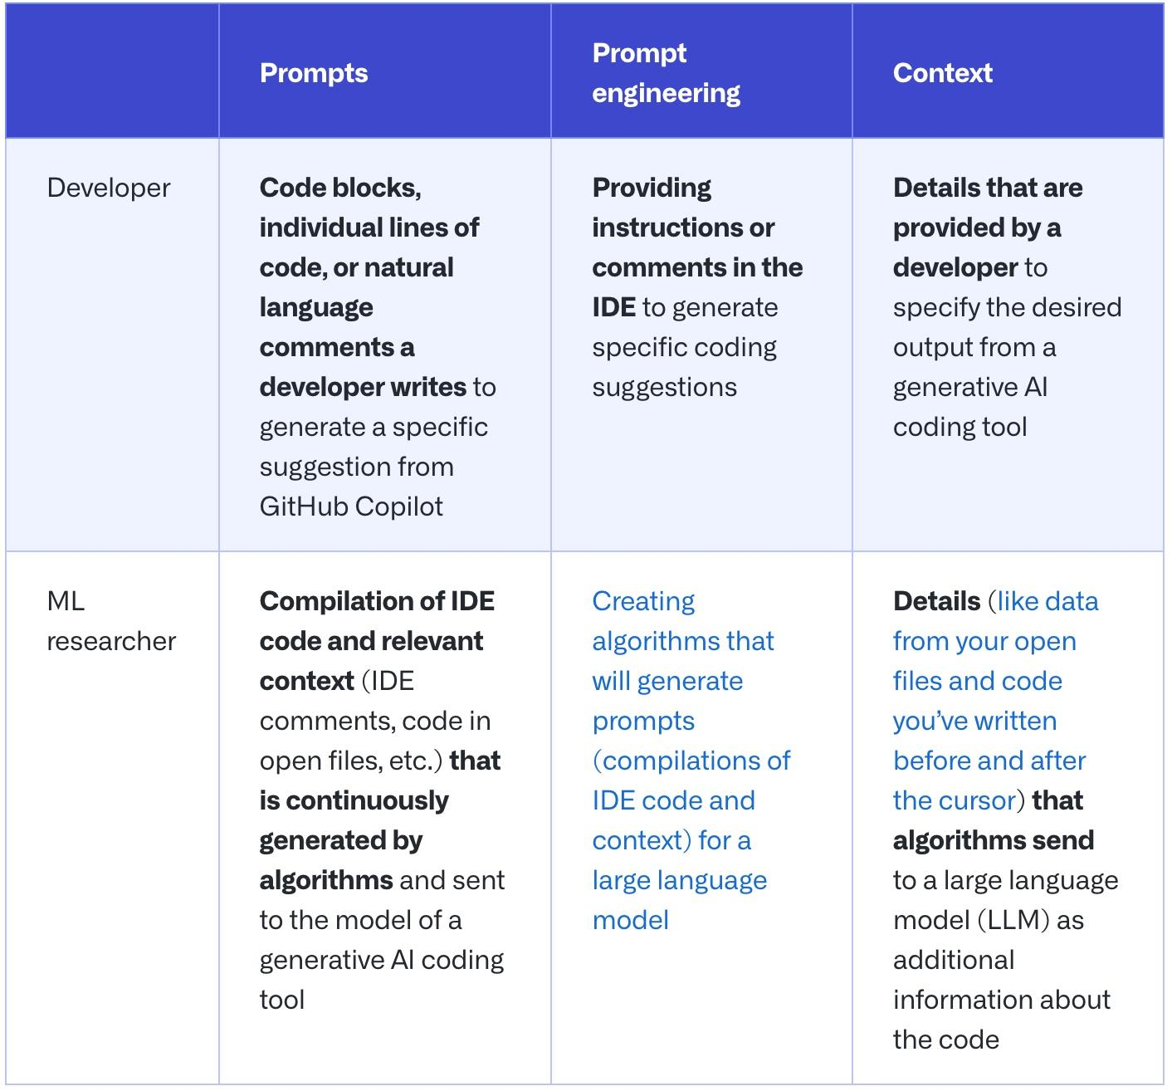
How to write better prompts for GitHub Copilot
what’s a prompt and what is prompt engineering
Notes:
这取决于你和谁说话。 在生成式 AI 编码工具中，提示可能意味着不同的含义，具体取决于您是询问正在构建和微调这些工具的机器学习 (ML) 研究人员，还是在 IDE 中使用这些工具的开发人员。

Slide 15
How to write better prompts for GitHub Copilot
Best Practice: Set the Stage with a High-Level Goal
Begin with a big picture description of what you want to accomplish.
Provide context to GitHub Copilot before diving into details.
Imagine having a conversation with someone to break down the problem.
Notes:
如果您有空白文件或空代码库，这将非常有帮助。换句话说，如果 GitHub Copilot 对您想要构建或完成的内容的上下文为零，那么为 AI 结对程序员设置舞台可能非常有用。在您开始详细介绍之前，它有助于为 GitHub Copilot 提供您希望其生成的内容的总体描述

Slide 16
How to write better prompts for GitHub Copilot
Best Practice: Set the Stage with a High-Level Goal
/*
Create a basic markdown editor in Next.js with the following features:
- Use react hooks
- Create state for markdown with default text "type markdown here"
- A text area where users can write markdown
- Show a live preview of the markdown text as I type
- Support for basic markdown syntax like headers, bold, italics
- Use React markdown npm package
- The markdown text and resulting HTML should be saved in the component's state and updated in real time
*/
Notes:
For example, when building a markdown editor in Next.jst, we could write a comment like this

Slide 17
How to write better prompts for GitHub Copilot
Best Practice: Set the Stage with a High-Level Goal
Notes:
For example, when building a markdown editor in Next.jst, we could write a comment like this

Slide 18
How to write better prompts for GitHub Copilot
Best Practice: Make You Ask Simple and Specific
Clearly communicate your main goal to the AI.
Break down the logic and steps it needs to follow for achieving the goal.
Ask GitHub Copilot to generate code step-by-step, rather than all at once.

Slide 19
How to write better prompts for GitHub Copilot
Best Practice: Make You Ask Simple and Specific
Notes:
Here’s an example of us providing GitHub Copilot with step-by-step instructions for reversing a function:

Slide 20
How to write better prompts for GitHub Copilot
Best Practice: Give GitHub Copilot an Example
Provide examples or sample input/output to help the AI understand your task.
Learning from examples is beneficial for both humans and AI.
Examples help GitHub Copilot produce more accurate and desired outcomes.
Notes:
Learning from examples is not only useful for humans, but also for your AI pair programmer. For instance, we wanted to extract the names from the array of data below and store it in a new array:

Slide 21
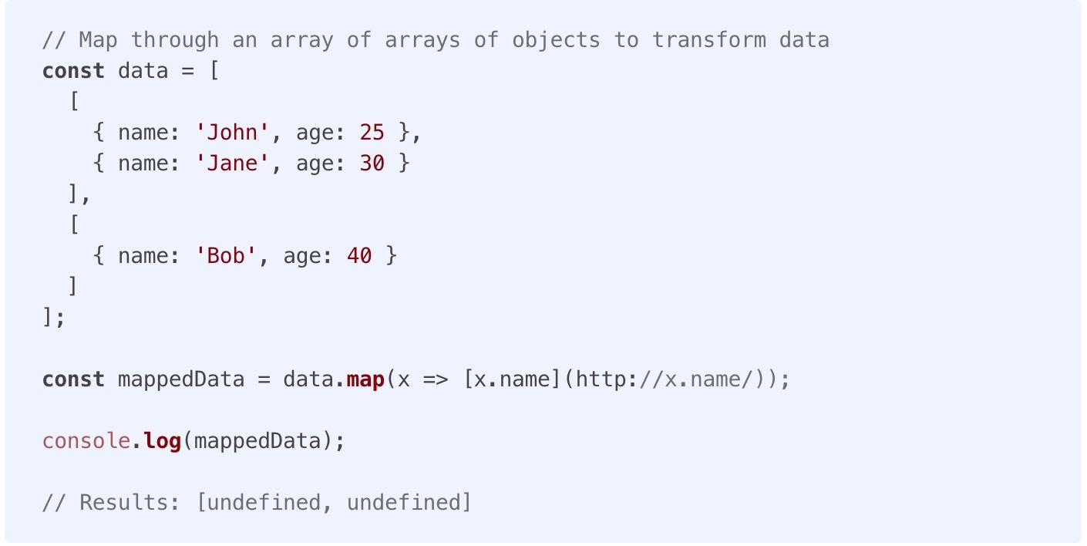
How to write better prompts for GitHub Copilot
Best Practice: Give GitHub Copilot an Example

Slide 22
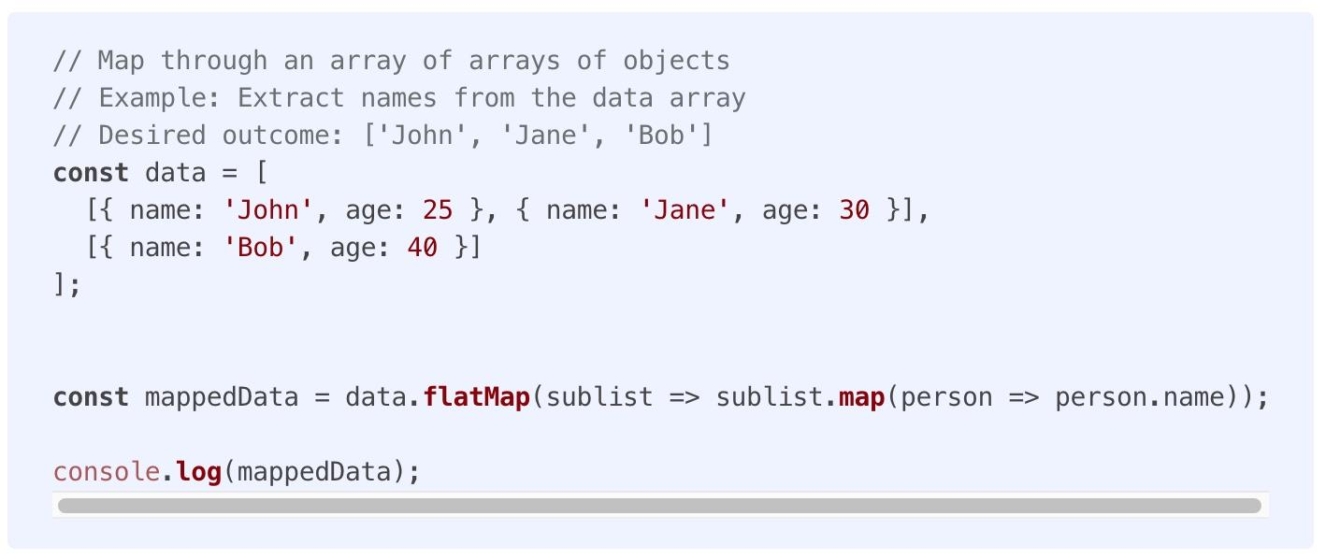
How to write better prompts for GitHub Copilot
Best Practice: Give GitHub Copilot an Example

Slide 23
How to write better prompts for GitHub Copilot
Good Coding Practices & Stay Smart
Good Coding Practices
Follow good coding practices like descriptive variable names, functions, and consistent coding styles.
GitHub Copilot encourages adherence to coding best practices.
Maintaining good practices results in more relevant and accurate code suggestions.
Stay Smart
The LLMs behind generative AI coding tools are designed to find and extrapolate patterns from their training data, apply those patterns to existing language, and then produce code that follows those patterns. Given the sheer scale of these models, they might generate a code sequence that doesn’t even exist yet. Just as you would review a colleague’s code, you should always assess, analyze, and validate AI-generated code.
Notes:
Learning from examples is not only useful for humans, but also for your AI pair programmer. For instance, we wanted to extract the names from the array of data below and store it in a new array:

Slide 24
How to design your Copilot with LLM
IDE
Feature: Chat, Add test, Code explain, others…
LLM
Model: Codex, AlphaCode, GPT-3.5, GPT-4, others …
https://github.com/feiskyer/chatgpt-copilot
https://marketplace.visualstudio.com/items?itemName=feiskyer.chatgpt-copilot
Notes:
IDE:
How to provide more precise prompts, building prompts lib based on ML.
Prompts should include contextual informations, not just the code.
LLM:
Large training code data.

Slide 25
How to quantify GitHub Copilot’s impact on developers
GitHub Offical Servery
After early observations and interviews with users, we surveyed more than 2,000 developers to learn at scale about their experience using GitHub Copilot.
Finding
Improving developer satisfaction. Between 60–75% of users reported they feel more fulfilled with their job, feel less frustrated when coding, and are able to focus on more satisfying work when using GitHub Copilot. That’s a win for developers feeling good about what they do!
Conserving mental energy. Developers reported that GitHub Copilot helped them stay in the flow (73%) and preserve mental effort during repetitive tasks (87%). That’s developer happiness right there, since we know from previous research that context switches and interruptions can ruin a developer’s day, and that certain types of work are draining
Notes:
GitHub Next conducted the experiment in partnership with the Microsoft Office of the Chief Economist, and specifically in collaboration with Sida Peng and Aadharsh Kannan.
60-75% 的用户表示，使用 GitHub Copilot 时，他们对工作感到更满足，编码时感到更少沮丧，并且能够专注于更令人满意的工作。
开发人员表示，GitHub Copilot 帮助他们保持流畅 (73%)，并在重复性任务期间保持脑力劳动 (87%)。这就是开发人员的幸福所在，

Slide 26
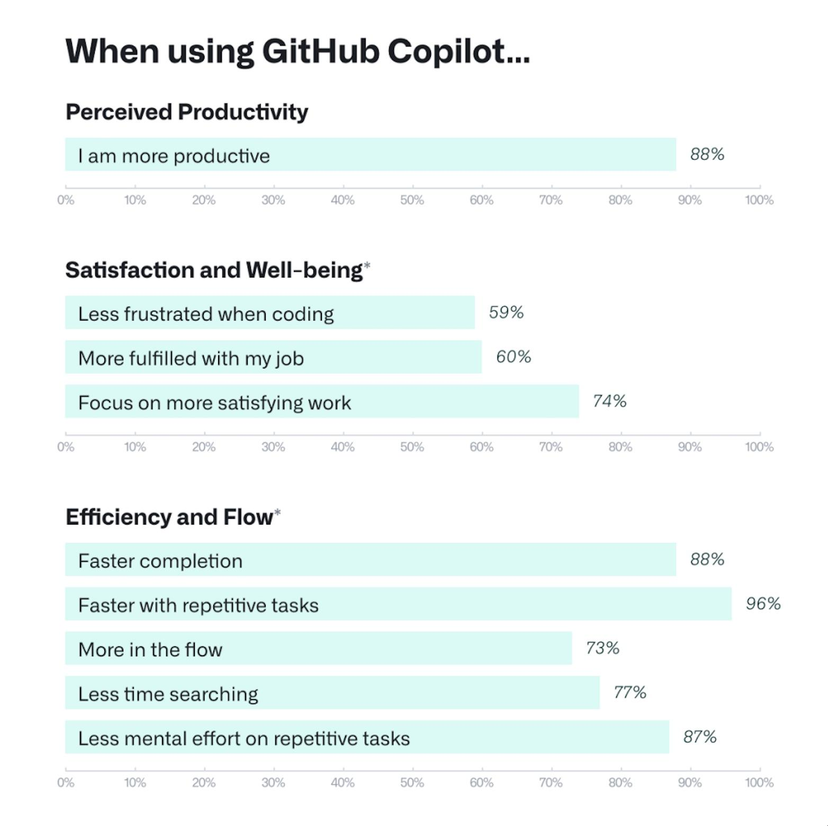
How to quantify GitHub Copilot’s impact on developers
GitHub Offical Servery

Slide 27
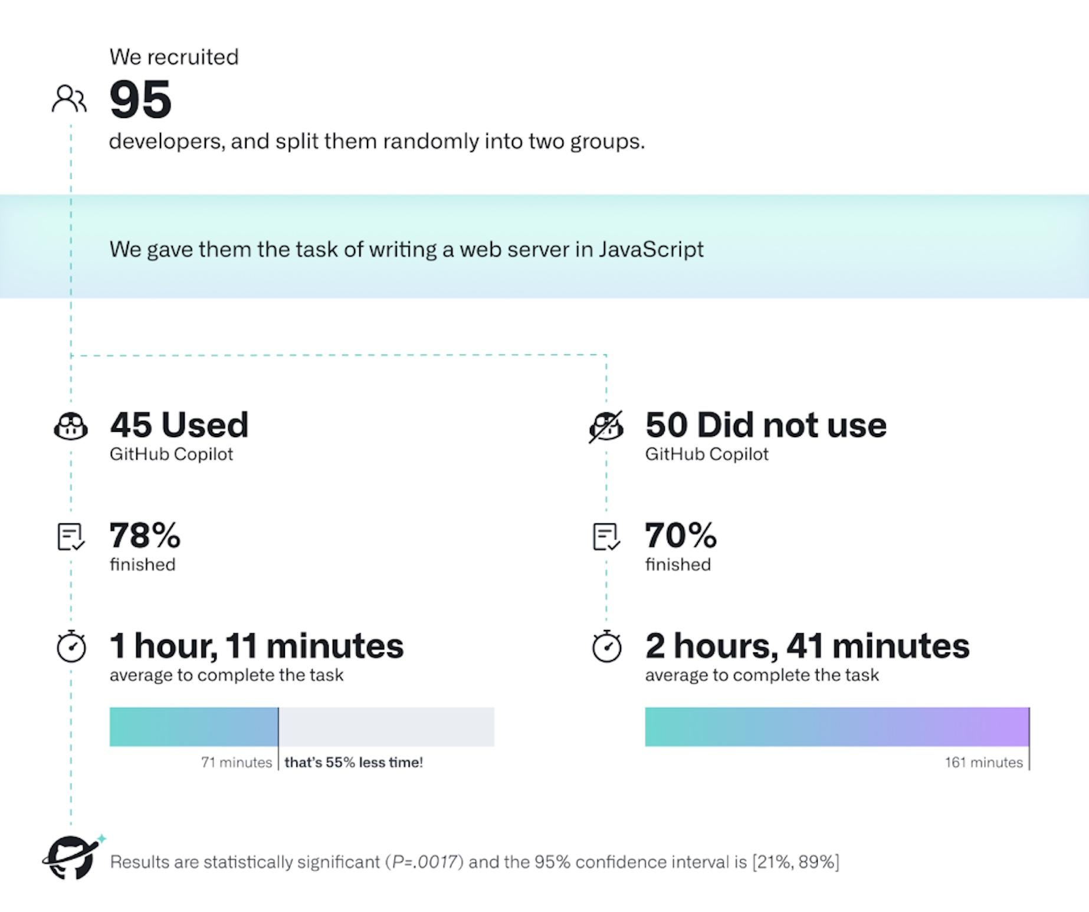
How to quantify GitHub Copilot’s impact on developers
GitHub Offical Servery
Notes:
GitHub Copilot 支持更快的完成时间，节省开发人员的精力，帮助他们专注于更令人满意的工作，并最终在编码中找到更多乐趣。GitHub Copilot 支持更快的完成时间，节省开发人员的精力，帮助他们专注于更令人满意的工作，并最终在编码中找到更多乐趣。

Slide 28
How to quantify GitHub Copilot’s impact on developers
GitHub Offical Servery
The striking difference was that developers who used GitHub Copilot completed the task significantly faster–55% faster than the developers who didn’t use GitHub Copilot.
Notes:
GitHub Copilot 支持更快的完成时间，节省开发人员的精力，帮助他们专注于更令人满意的工作，并最终在编码中找到更多乐趣。GitHub Copilot 支持更快的完成时间，节省开发人员的精力，帮助他们专注于更令人满意的工作，并最终在编码中找到更多乐趣。

Slide 29
What is the next GitHub Copilot
GitHub Copilot X
GitHub Copilot X aims to bring AI beyond the IDE to more components of the overall platform, such as docs and pull requests. LLMs are changing the ways that we interact with technology and how we work, and ideas like GitHub Copilot X are just an example of what these models, along with some dedicated training techniques, are capable of.
Notes:
2023 年 3 月，GitHub 宣布了 Copilot 的未来，即 GitHub Copilot X，这是我们对人工智能驱动的开发人员体验的愿景。 GitHub Copilot X 旨在将 AI 超越 IDE 带到整个平台的更多组件，例如文档和拉取请求。 LLM 正在改变我们与技术交互的方式以及我们的工作方式，像 GitHub Copilot X 这样的想法只是这些模型以及一些专用培训技术的.

Slide 30
Insights
Pros
Copilot can quickly generate code snippets, reducing the amount of code developers need to write manually.
Copilot is trained on a large of existing codebases, it often generates well-structured and maintainable code.
Beginners can learn new programming concepts by observing the code generated by Copilot.
Multiple language supporting, developer can read/write unknown language in different project
Cons
Copyright issue
Security issue
Misalignment
Developer coding skill may impacted
Economic and labor market impacts

Slide 31
Insights
Individual Productivity VS Team Collaboration
Requirement Analyze
Testing
Coding
Release
Design
TISO
Notes:
以Digital为例，一个产品要上线。至少要有以上的流程，而coding在整个项目周期所处的地位并不高。所以工具会让个人效率提高了，但对整个项目生命周期产生的正面效果并不多。团队协作依然是项目开发中最重要的环节

Slide 32
Insights
Automation VS Uncertainty
Reduce completion time of certain task thru automation
Simply having more people or higher individual productivity doesn't always resolve the complexities of project management.
《Mythical Man-Month》
Notes:
通过自动化工具容易给PM一种积极乐观的项目进度假象。就像书里面说的“粗暴的加人和提高个人效率并不能完全解决项目的不确定性和复杂性”

Slide 33
Insights
Efficiency VS Innovation
Tools aims to increase coding efficiency thru auto-completion
Efficiency != Innovation. Using tools can make us focus on completion, but not innovation.
Notes:
工具的目的是快速完成代码编写，提高效率。 而为了完成自动编写，需要对存量代码进行训练，而并不会生产出有创造性的代码。 当我们聚焦在完成任务的时候，创新就会很困难。

Slide 34
Insights
Learning VS Perfessional
By using tools, everyone can enter to software industry.
Software development requires a deep understanding project management, team collaboration, architecture design.
Notes:
降低了软件开发的入门门槛，使初学者更容易上手。虽然 Copilot 可以帮助初学者快速入门，但它不能替代经验和专业知识。软件开发不仅仅是编写代码，还需要对项目管理、团队协作和软件架构有深入的理解。

Slide 35
Insights
Others
Refactor, well documentation is requred, code quality, mantenance
Copilot is powerful, but still can’t fully replace traditional software philosophy.
Copilot is so powerful that every developer need to improve soft skills
Notes:
工具很好，但是仍然无法影响传统软件开发的理论。 工具太优秀，因此每个人还需要提高自身软实力。

Slide 36
Insights
Action
Simple and repetitive tasks can be solved by AI. We dont need more junior engineer, we need more senior developer with high capability.
Fundatmental Skill Improve
English Proficiency
Learning Ability
System/Innovation Thinking
Business Understanding

Slide 37
References
Evaluating Large Language Models Trained on Code(https://arxiv.org/pdf/2107.03374.pdf )
Prompt Engineering Guide (https://www.promptingguide.ai/)
Working with the LLMs behind GitHub Copilot(https://github.blog/2023-05-17-inside-github-working-with-the-llms-behind-github-copilot/)
GitHub Copilot (https://github.blog/2023-05-17-how-github-copilot-is-getting-better-at-understanding-your-code/)
GitHub Copilot Quantifying impacts (https://github.blog/2022-09-07-research-quantifying-github-copilots-impact-on-developer-productivity-and-happiness/)
How to use GitHub Copilot (https://github.blog/2023-06-20-how-to-write-better-prompts-for-github-copilot/)
Intensive reading of deep learning papers (https://github.com/mli/paper-reading )

Slide 38
Thank You

